Slide 1
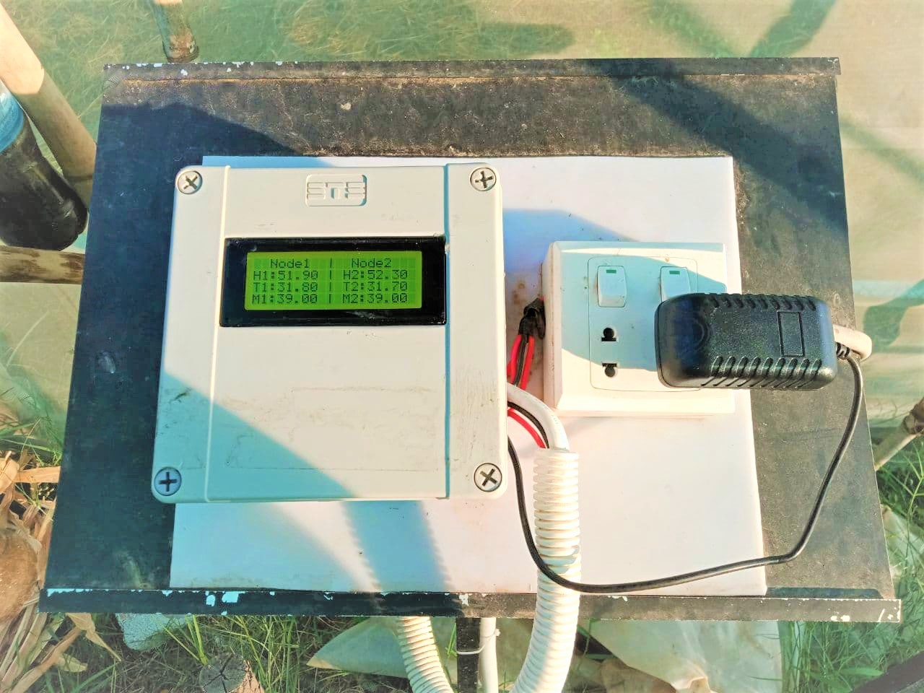
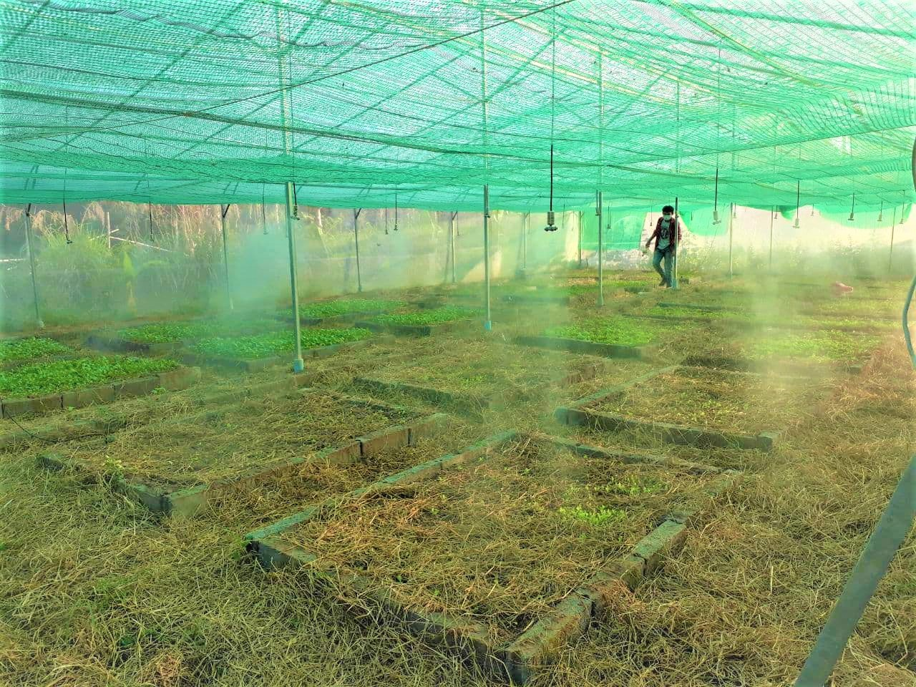
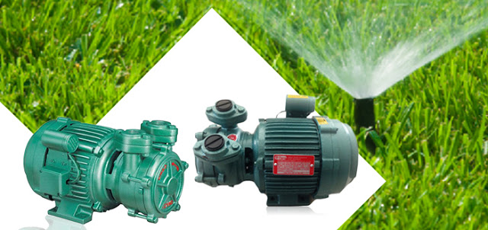
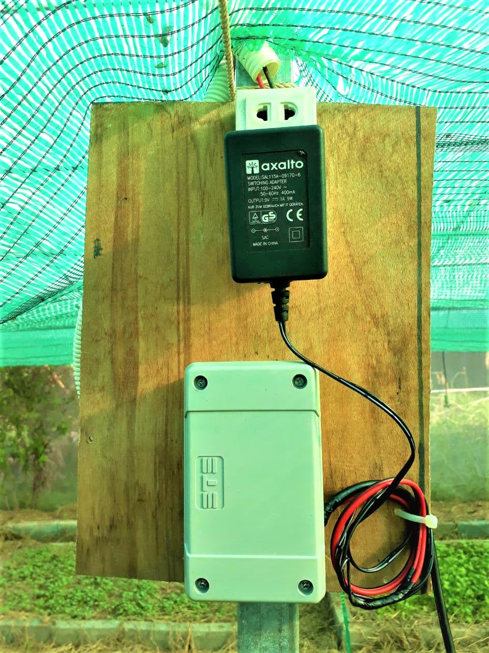
RUA
AUTOMATIC IRRIGATION SYSTEM
ARCHITECTURE

Slide 2

Communication
Coordinator
ZigBee
ZigBee
ZigBee
Node 1
Node 2

Slide 3
Node 1
Arduino
ZigBee
Soil moisture
Temp. & Humidity

Slide 4
Node 2
Arduino
ZigBee
Soil moisture
Temp. & Humidity

Slide 5
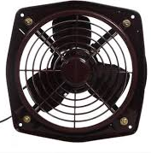
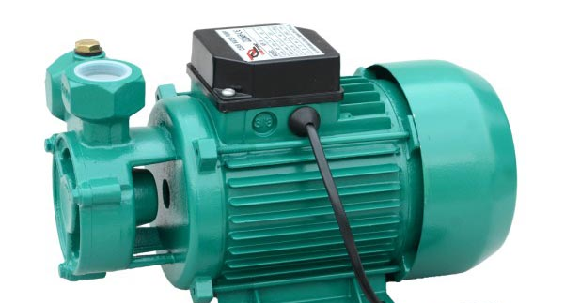
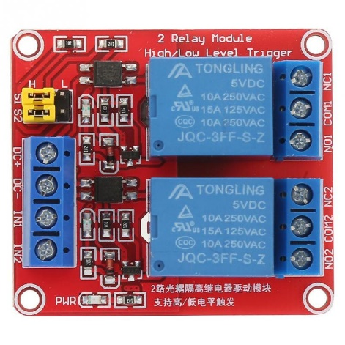
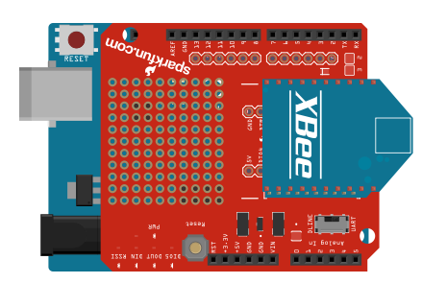
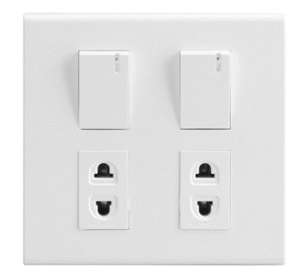
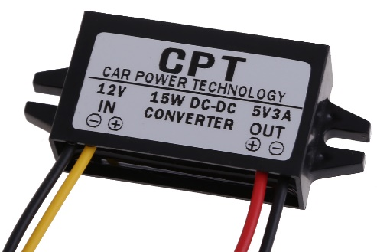
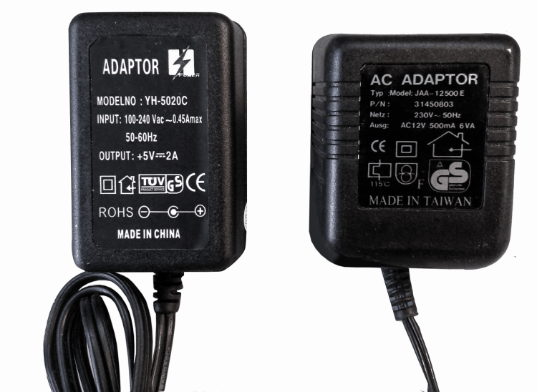
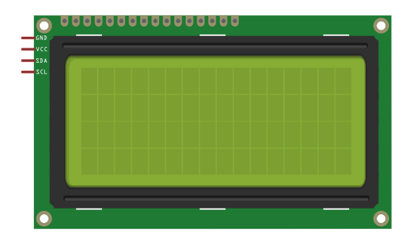
Coordinator
Relay
Switch-Motor
Switch-Fan
12V
AC(220V)
Converter
12V to 5V
LCD

Slide 6
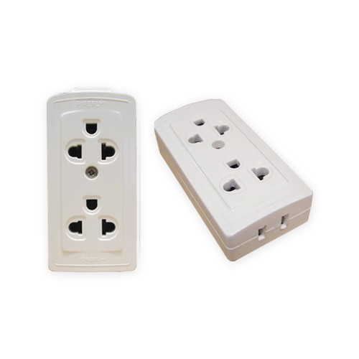
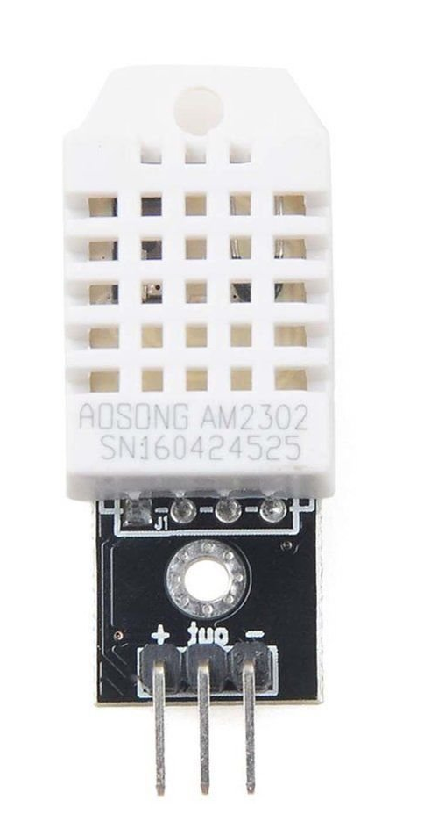
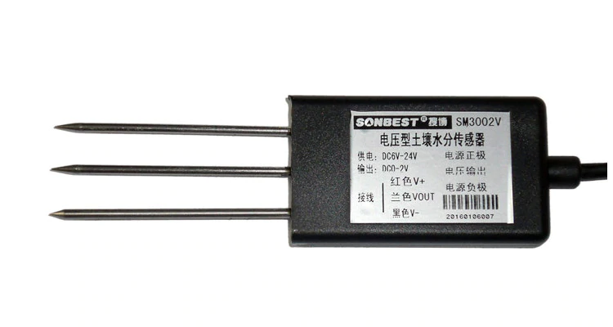
Node 1
12VDC
AC(220V)
Temp. & Humidity
Soil Moisture

Slide 7
Node 2
12VDC
AC(220V)
Temp. & Humidity
Soil Moisture

